Slide 1
Serving NIH, Intramural Investigators, and Collaborating Research Sites & Institutions

Slide 2

WCG Attendees
Jeff Cooper, MD Deena Horowitz
Vice President, Process & Strategic Improvement Account Manager
Dawn Flitcraft Jonathan Zung, PhD
President, Ethical Review Division Executive Vice President, Site Division
Christopher Gennai, CIP
Senior Account Manager
Charlie Eibeler
Senior Director, Business Development

Slide 3

Institutions (NIH and your Collaborators)
Part of WIRB’s DNA
1996 – University of Rochester
Today
  2,800 + Hospitals
  220 Academic Medical Centers
WIRB operations organized specifically for institutions
WIRB knows how your collaborators operate
WIRB flexes to institutional requirements (NIH’s and your collaborating institution’s requirements)
Dedicated Account Managers
Dedicated Executive Leaders
WIRB is the only dedicated institutional IRB partner

Slide 4
WIRB Eliminates the Biggest Frustrations that Impede sIRB Reviews
Participating institution needs to have a reliance agreement with sIRB
Participating institutions have differing workflows
Participating institutions have idiosyncratic requirements for consent forms
WIRB has standing reliance agreements with over 3,000 institutions
Institutional workflows are already embedded in our processes and technology
Institutional template consents already integrated into our processes and technology
WIRB seamlessly plugs you into the process just as with industry sponsors
Notes:
TALKING POINTS:
Participating institution needs to have a reliance agreement with sIRB
Reliance agreements take time to negotiate.
Reliance agreement required by regulation. Each institution may have specific requirements that the sIRB may not be able to fulfill. E.g., insistence on using AAHRPP accredited IRB, stipulations on who evaluates and reports non-compliance.
Participating institutions have differing workflows
E.g., Checking that local requirements before commencing review, legal review prior to issuing final approval, who gets notifications.
WIRB knows local requirements and who must be notified at each institution
WIRB has standing reliance agreements with over 3000 institutions. 2800 hospitals and 220 AMCs
Standing existing agreements with each institution – Pre-negotiated. No headache over reliance agreement.
Broader than most reliance agreements.
Reliance agreements include workflow requirements (“rules-of-the-road”) and template consent for each institution
Institutional workflows are already embedded in our processes and technology
Pre-negotiated in standing existing agreements.
Gatekeeping functions
Workflows
Local context considerations
Institutional template consents already integrated into our processes and technology
WIRB will adapt your ICF to the institution’s required template
No need for participating site to develop a local consent form

Slide 5
IRB Review & Oversight Services
Two modes of service for multicenter clinical trials
Industry-Sponsored
NIH Investigator-Sponsored
NIH added as a site
Expedited review
3 to 5 business days
NIH PI has site view of submission portal
Direct bill to sponsors (NO COST to NIH) or identified contact in the submission form for IRB review
Budget based on contracts
NIH PI is site and SPONSOR
Full board review
7 to 9 business days
NIH PI has site and SPONSOR view - site PIs have site view
Cost of protocol-level and site-level reviews charged to the identified contact in the submission forms
Budgets developed via consultation

Slide 6
Development of Budgets for WIRB sIRB Services
A 3-step process: we develop budgets for you
Step 1
Investigator completes a short questionnaire
Step 2
Investigator/Staff and
WIRB have a brief
(15- 30 min.) phone call
Step 3
WIRB delivery

Slide 7
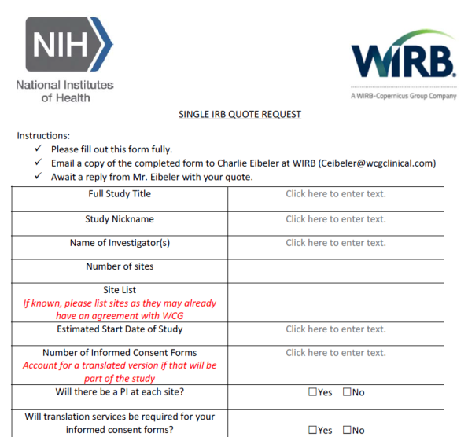
Step 1: WIRB sIRB Services Questionnaire
The starting point for your IRB review budget

Slide 8
Step 2: Consultation Phone Call
A brief (15 to 30 min) conversation to reach mutual understanding
Confirm answers in the questionnaire
Discuss cost drivers and prudent budgeting process
Adjust answers in questionnaire, as required
Discuss caveats and uncertainties
Level-set investigator expectations

Slide 9
Step 3: Budget Delivery to Investigator
One business day after consultation
Year-over-year budget for study duration
List of underlying cost-driving assumptions
Note that changes in utilization can change fees
  Budget will hold if assumptions are true
  If additional services are required, costs will increase
  If fewer services are required, costs will decrease
Note that translations are not included
Single IRB Plan
Optional follow-up call, if desired by Investigator

Slide 10
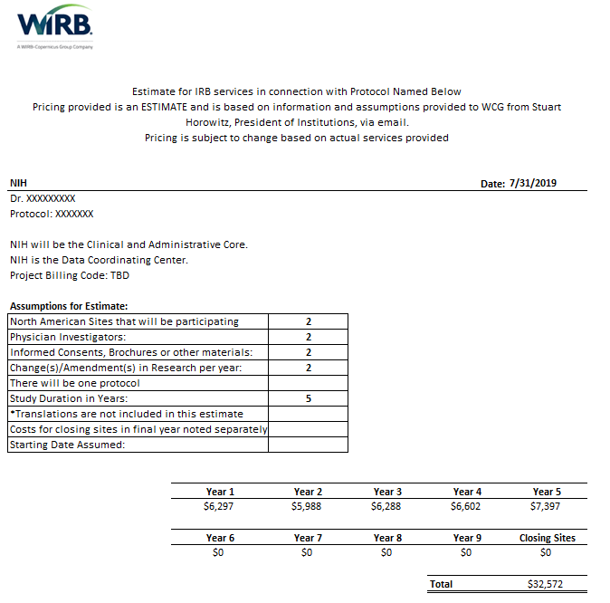

Slide 11
Submission Process to Western IRB

Slide 12


WIRB as NIH’s Collaborative Partner
Specific, customized rules tailored to NIH needs
  NIH Institutional Review Memo
  Unique COI Process
  NIH ICF Template Language
We follow the workflow and consent template of participating institutions, as well as the NIH workflow and consent template
We are here to work with you!
  Dedicated Account Managers who understand NIH-specific needs
  Account Managers are available for on-site visits, phone calls, and by email for standard, urgent, or escalated issues
Notes:
Call out investigators should familiarize themselves with the WIRB handbook and reporting timeframes

Slide 13
Submission Process Agenda
Submission Process Overview
WIRB Smart Application Forms
  Initial Review
  Changes in Research (modifications and amendments)
  Continuing Review
  Promptly Reportable Information
MyConnexusTM Overview
  Create an account
  Send submissions
  Add others to your study or site workspace

Slide 14

Process Overview: Protocol Submission
When protocol is ready for IRB review, provide WIRB with initial review application and NIH template consent
Use the WIRB Initial Review Submission Form Combined Submission Option
Include NIH required documents and custom budget with your submission
WIRB reviews the protocol and creates an approved NIH template consent
This can be done before selection of participating institutions is finalized
WIRB sends approval letter to NIH PI with approved NIH template consent
We will make sure that approved NIH template consent follows NIH standards
Notes:
Pointout that this step happens after the NIH IRBO has issued its Institutional Review Memo. WIRB requires the memo to review the submission.

Slide 15
Process Overview: Site Submissions
Each participating institution (except NIH) submits a site application
WIRB reviews site application using the approved NIH template
WIRB approves a site-level consent for each participating institution
Study starts
Sites do not have to submit consent forms
WIRB sends an approval letter and approved local consent form to each institution, and can also send the letter to NIH
WIRB generates an institutional consent form based on the NIH template and institutional template

Slide 16
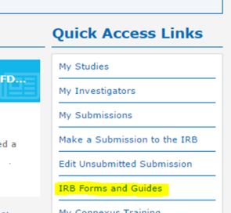
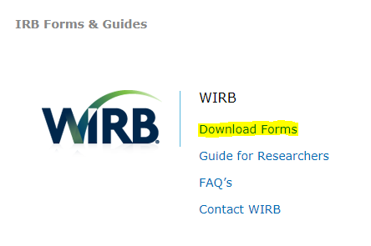
Obtaining WIRB Forms
Smart PDF forms are available in two locations:
WIRB.com > Download Forms
MyConnexus (connexus.wcgclinical.com) > IRB Forms and Guides (under Quick Access Links)
Notes:
Call out the Guide for Researchers

Slide 17
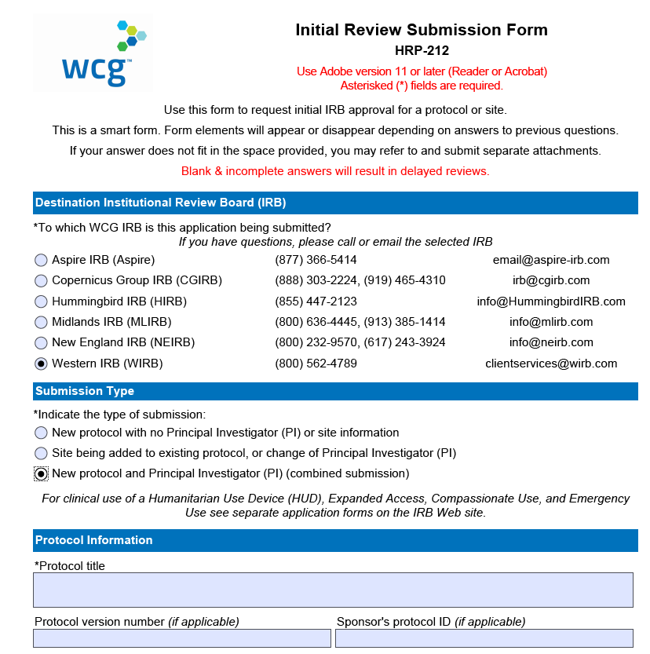
WIRB Smart Forms: Initial Review Form
Provides step-by-step instructions to complete the application
Depending on answers, additional questions and directions may appear
Compatible with PCs and Macs using free Adobe Reader

Slide 18

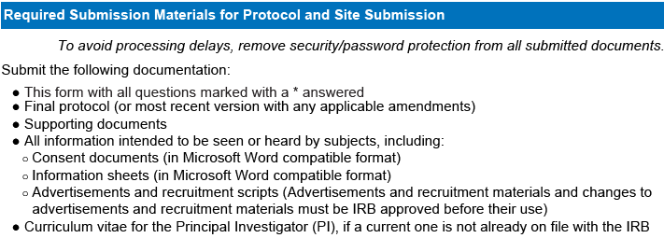

Submission Documents
The form will guide you as to what documents are required for submission
  There will be signs in the form if supplemental forms are required
Reference the end of the form for a list of required documents
The form includes a tool to check for missing entries
  Missing entries will be highlighted

Slide 19
WIRB Smart Form PDF Advantages Over Web Forms
Can be filled out without being connected to the Internet
Can be shared for review by others without logging on to MyConnexus
For sections where the information rarely changes, you can fill out a form partially and save it as a starter template for future studies
Can be easily saved and restarted from where you left off

Slide 20

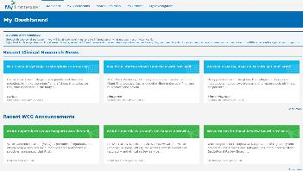
MyConnexusTM: Your Submission Portal
MyConnexus is the information portal to WIRB
MyConnexus allows you to:
  Submit applications for approval
  Review communications from WIRB
  Retrieve approved outcome documents
  Review protocol history
  Review information at participating sites

Slide 21
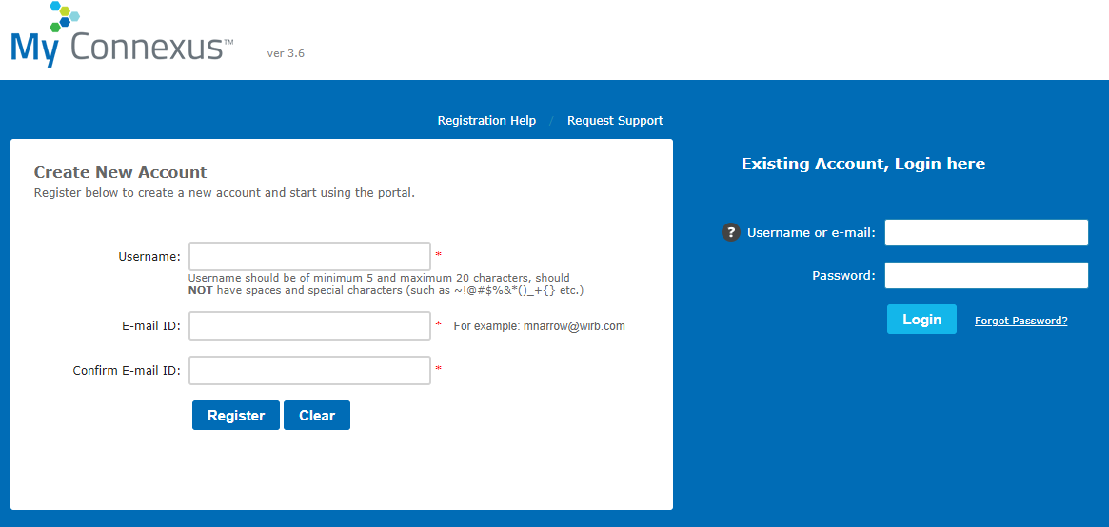
MyConnexus: Create Your User Account
Register for an account at connexus.wcgclinical.com
  Registration process is the same for all users
  You can invite others to create an account when adding them to your study workspace

Slide 22
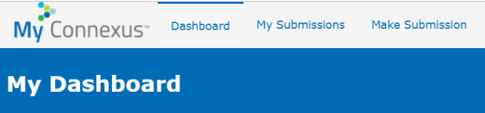
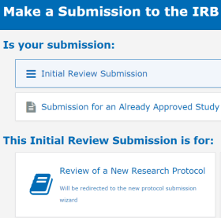
MyConnexus: Simple Steps to Submit
Only a few simple steps necessary to submit your study
  Click the “Make Submission” tab
  Select “Initial Review Submission” and “Review of a New Research Protocol”
  Upload documents and submit!

Slide 23
After You Submit: What to Expect
You receive a Submission Tracking Number
A WIRB Board Panel reviews the research
You receive an email with a link to all WIRB outcome documents
Outcome documents are posted to MyConnexus for reference
You will receive a Certificate of Action (COA):
  Board Action Date (Approval Date)
  Expiration Date
  Approved Research Location(s) and PI
  The documents that were reviewed
  List of study personnel on the email distribution list

Slide 24
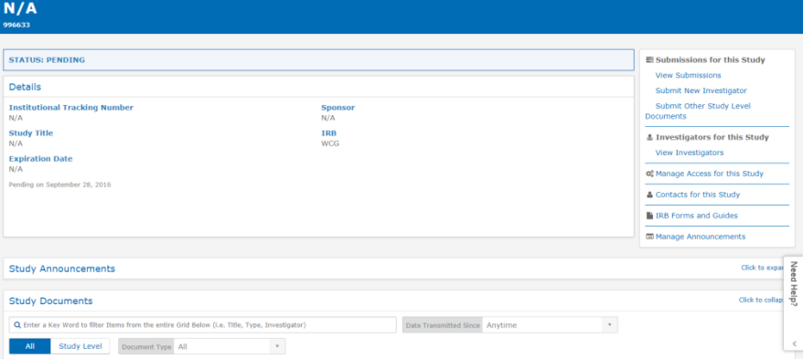
MyConnexus: Study Workspace Management
You can add others to the MyConnexus workspace for your study
View all active Investigators/Sites using the “View Investigators” link

Slide 25
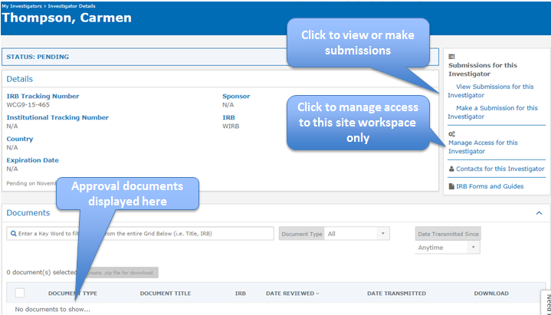
MyConnexus: Site Workspace Management
Sites can add others to the MyConnexus workspace for their PI

Slide 26
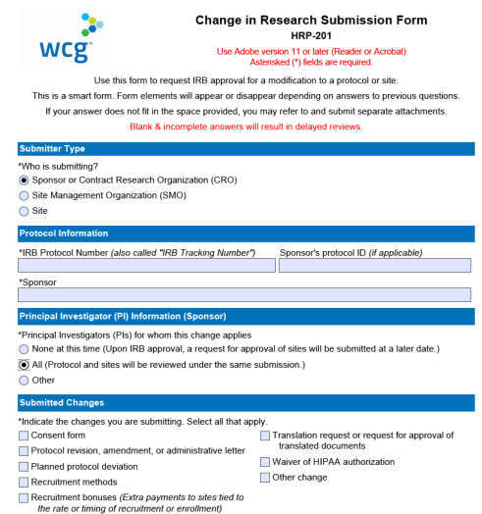
Modifications and Amendments
Amendments and modifications can be submitted using our “Change in Research” form
  You can specify if the change is occurring at all sites or a subset
  Sites can also submit site-specific changes
  If consent form changes were submitted or needed:
    WIRB reviews modified template NIH consent document
    WIRB applies change to all indicated site consent forms

Slide 27
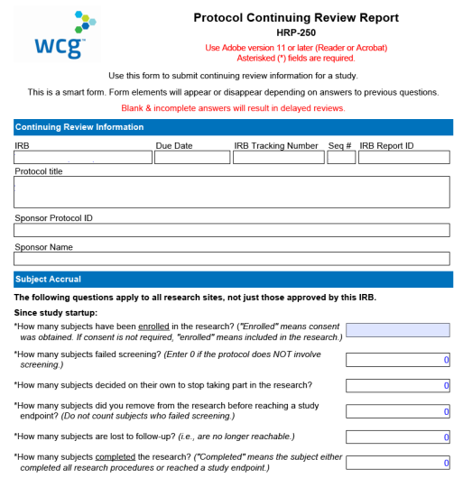
Continuing Review
The “Protocol Continuing Review Form” will be sent automatically to the individual(s) listed on the Initial Review form
  The protocol approval and all site approvals expire on the same date
  Three months before expiration, WIRB begins the renewal process
  Information is due 56 days before expiration and periodic reminders will be sent
All continuing review reports are reviewed at the same time
WIRB sends approvals to protocol PI and all site PIs at the same time

Slide 28
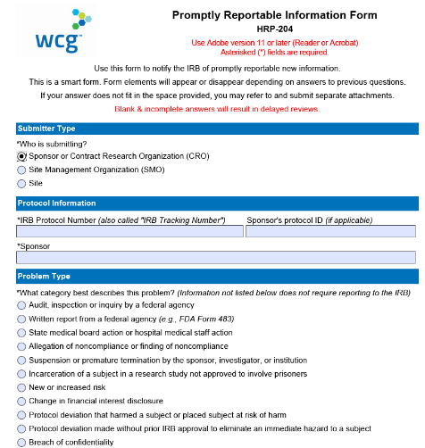
Reportable Information (AEs, UPs, etc.)
The “Promptly Reportable Information” form is used to report any adverse events or unanticipated problems
  The form will guide you as to what problems to report
  Reports can come from a PI, co-investigator, research staff, or institution
  WIRB will review the report and if significant, communicate with appropriate parties
  WIRB will notify and work collaboratively with NIH, NIH PI, Institutions or Institution PIs on reporting to OHRP/FDA

Slide 29
We Are Here to Partner With You – Contact Us!
Budgeting Questions
Charlie Eibeler
+1 919.244.9887 | ceibeler@wcgclinical.com
IRB Questions
Deena Horowitz
+1 360.252.2442 | dhorowitz@wirb.com
Christopher Gennai, CIP
+1 360.252.2460 | cgennai@wirb.com

Slide 30
Thank You

