Slide 1
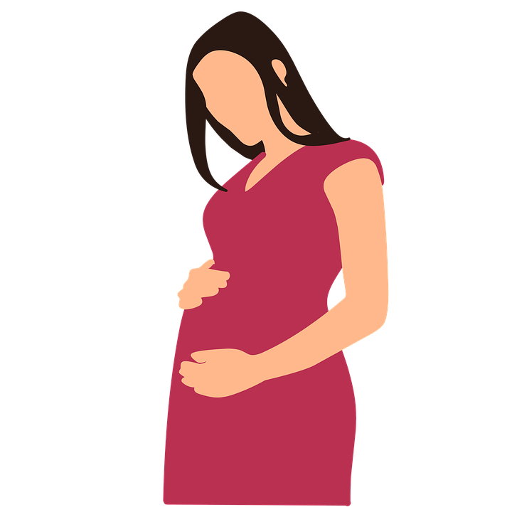

Research Involving Pregnant Women
What Should the IRB Consider When
Reviewing Research Involving Pregnant Women?

Slide 2
Why Enroll Pregnant Women in Clinical Trials?
1978: The Belmont Report
One of the three basic ethical
principles discussed in the Belmont
Report is Justice
Exclusion of pregnant women
from clinical research may result in
an unfair denial of benefits to the
woman and/or fetus that are unavailable
outside the research setting
Women need safe and effective treatment during pregnancy with pharmacokinetic information to identify appropriate therapeutic doses during pregnancy and to quantify risks of fetal exposure
Justice

Slide 3

Historical Background
1975: HHS adopted regulations concerning pregnant women as research participants and included pregnant women as a “vulnerable population” deserving of special protection
Regulations took a proscriptive approach: “No pregnant woman may be involved in research unless. . .”
1994: The Institute of Medicine (IOM) report, Women and Health Research: Ethical and Legal Issues of Including Women in Clinical Studies, commented on the HHS regulations
related to research with pregnant women
(Subpart B) noting the following:
“Removal of pregnant women from the regulatory
category of "vulnerable" potential participants would
avoid any possible inference that pregnant women
are less capable of making informed decisions by
virtue of their pregnancy, than are other potential
research participants.” continued

Slide 4
Historical Background-IOM
The IOM:
Urged that the prevailing presumption
regarding the participation of pregnant
women in clinical trials and other
intervention studies be shifted from one
of exclusion to one of inclusion
Unanimously endorsed the importance
of recognizing in public policy and in the
decisions made by IRBs and investigators,
that pregnant women should be treated
as competent adults capable of making
their own decisions about participation
in research
Noted that it is the responsibility of investigators and IRBs to ensure that pregnant women are provided with adequate information about the risks and benefits to themselves, their pregnancies and their potential offspring
Justice
Autonomy
(Respect for persons)

Slide 5
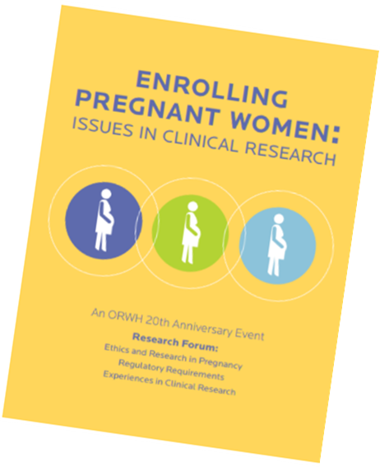
Historical Background-Regulatory Update
In 2001, Subpart B of 45 CFR 46 that addresses research with pregnant women, fetuses and neonates was modified to its current language
Rather than the former proscriptive approach (“No pregnant woman may be involved in research unless. . .”), the 2001 regulations stated “Pregnant women or fetuses may be involved in research if all the following conditions are met….”
In 2010, the NIH Office of Research on Women’s Health (ORWH) convened a workshop, Enrolling Pregnant
Women: Issues in Clinical Research:
As was the case in the IOM report, the ORWH emphasized the need to change the presumption
of exclusion of pregnant women to one of inclusion
Report reiterated that identifying pregnant women
as a vulnerable population is a misnomer

Slide 6
Finally a Change! (But NOT to Subpart B)
Pre-2018 Common Rule:
“When some or all of the subjects are likely to be vulnerable to coercion or undue influence, such as children, prisoners, pregnant women, mentally disabled persons, and economically or educationally disadvantaged persons, additional safeguards have been included in the study to protect the rights and welfare of these subjects.”[Emphasis added.]
The Revised Common Rule (the 2018 Requirements)*
The IRB should be particularly cognizant of the special problems of research involving that involves a category of subjects who are vulnerable populations to coercion or undue influence, such as children, prisoners, pregnant women, mentally disabled persons individuals with impaired decision-making capacity, or economically or educationally disadvantaged persons
*Blue font is new wording

Slide 7
45 CFR 46 (Subpart B): Enrollment of Pregnant Women or Fetuses in Trials Supported or Conducted by HHS
Must meet all 10 conditions:
Where scientifically appropriate, preclinical studies, including studies on pregnant animals, and clinical studies, including studies on nonpregnant women, have been conducted and provide data for assessing potential risks to pregnant women and fetuses
How much preclinical data are sufficient?
Does the preclinical animal research include reproduction studies?
The risk to the fetus is caused solely by interventions or procedures that hold out the prospect of direct benefit for the woman or the fetus; or, if there is no such prospect of benefit, the risk to the fetus is not greater than minimal and the purpose of the research is the development of important biomedical knowledge which cannot be obtained by any other means
What does “the risk to the fetus is not greater than minimal” mean?
continued

Slide 8
45 CFR 46 (Subpart B): Enrollment of Pregnant Women or Fetuses in Trials Supported or Conducted by HHS
  3. Any risk is the least possible for achieving the objectives of the research
  If the research holds out the prospect of direct benefit to the pregnant woman, the prospect of a direct benefit both to the pregnant woman and the fetus, or no prospect of benefit for the woman nor the fetus when risk to the fetus is not greater than minimal and the purpose of the research is the development of important biomedical knowledge that cannot be obtained by any other means, [and] her consent is obtained in accord with the informed consent provisions of Subpart A
continued

Slide 9
45 CFR 46 (Subpart B): Enrollment of Pregnant Women or Fetuses in Trials Supported/Conducted by HHS
  5. If the research holds out the prospect of direct benefit solely to the fetus then the consent of the pregnant woman and the father is obtained in accord with the informed consent provisions of 45 CFR 46, subpart A, except that the father's consent need not be obtained if he is unable to consent because of unavailability, incompetence, or temporary incapacity or the pregnancy resulted from rape or incest
  Each individual providing consent is fully informed regarding the reasonably foreseeable impact of the research on the fetus or neonate
continued

Slide 10
45 CFR 46 (Subpart B): Enrollment of Pregnant Women or Fetuses in Trials Supported or Conducted by HHS
  7. For children as defined in §46.402(a) who are pregnant, assent and permission are obtained in accord with the provisions of 45 CFR part 46, subpart D “Additional Protections for Children Involved as Subjects in Research”
  8. No inducements, monetary or otherwise, will be offered to terminate a pregnancy
  9. Individuals engaged in the research will have no part in any decisions as to the timing, method, or procedures used to terminate a pregnancy
  Individuals engaged in the research will have no part in determining the viability of a neonate

Slide 11
Research Involving Pregnant Minors
Subpart D defines children as persons who have not attained the legal age for consent to treatments or procedures involved in the research, under the applicable law of the jurisdiction in which the research will be conducted
The IRB should be familiar with applicable law of the jurisdiction in which a study will be conducted
Non-US sites may define “children” differently
This age also varies in a few US states
MAS policy (M77-2): Defines an adult as anyone 18 years of age or older. “For purposes of providing consent, a minor who is married or a parent may also be considered an adult at the Clinical Center”

Slide 12
Need for Parental Permission vs.
Consent Provided by a Pregnant Minor
Question: “If by law a child is able to consent to treatment without parental permission, can they also consent to participate in research related to that treatment?”
Answer: “. . . If research on a specific treatment involves solely [emphasis added] treatments or procedures for which minors can give consent outside the research context (under applicable state and local laws, for example, research on sexually transmitted diseases or pregnancy), such individuals would not meet the definition of children as defined at 45 CFR 46.402(a). Thus, subpart D would not apply to the research and parental permission (or waiver thereof) is not a consideration for these minors. Under these circumstances, minors may provide their own informed consent.”
OHRP Research with Children FAQs

Slide 13
IRB Responsibilities
The IRB should first determine:
Does the research have the
prospect of direct benefit to the
mother and/or to the fetus?*
Is the research no greater than
minimal risk or does the research have
a greater than minimal risk to the mother
and/or the fetus?**
*Clinical Care is not considered a benefit of research
**Unlike HHS Subpart D regulations (research involving children), regulations for research involving pregnant women do not include consideration of research that represents a “minor increase over minimal risk,” though addition of such a category was recommended in the 2018 report to the Secretary of HHS by the Task Force on Research Specific to Pregnant Women and Lactating Women (established by the 21st Century Cures Act)
Justice
Autonomy
Beneficence

Slide 14
When Research Involves Pregnant Women and Has Prospect of Direct Benefit
Research that has the prospect of direct benefit (DB) to the pregnant woman and/or the fetus is generally approvable even if greater than minimal risk when the other Subpart B requirements are also met
Consent of the pregnant woman alone is sufficient in this case unless the research has the prospect of DB only for the fetus
If the DB is only for the fetus, the consent of both the pregnant woman and the father is required unless the father is unable to provide consent because of unavailability, incompetence, or temporary incapacity or the pregnancy resulted from rape or incest

Slide 15
When Research Involves Pregnant Women and There is NO Prospect of Direct Benefit
When there is no prospect of DB to the mother or fetus, the IRB may only approve the research if the risk is no greater than minimal, and the “purpose of the research is the development of important biomedical knowledge that cannot be obtained by any other means.”
For such a protocol, in order to gain the important biomedical knowledge that is the intent of the protocol, enrollment of pregnant women will be needed
The PI must provide a justification in the protocol and the IRB must subsequently determine that the aim of gaining such knowledge cannot be achieved by enrolling only nonpregnant participants

Slide 16
Research > Minimal Risk with
No Prospect of Direct Benefit
Research involving pregnant women that is greater than minimal risk with no prospect of direct benefit to the pregnant woman or the fetus cannot be approved by the IRB
For studies that do not enroll pregnant women and that are greater than minimal risk, the protocol should address what will happen if participants become pregnant during the course of the study
For treatment studies:
The protocol should indicate if pregnancy is an off-treatment criterion
If the participant’s partner becomes pregnant, the IRB must review and approve a consent form allows the partner to provide consent to have pregnancy outcome data collected, and the protocol should be revised to include a pregnant partner cohort
For FDA regulated research, pregnancy outcome should be collected and reported

Slide 17
What if a Participant Becomes Pregnant While on a Study with no Prospect of DB for the Pregnant Woman or Fetus?
If a participant becomes pregnant during the course of the study that provides no direct benefit and the protocol indicates that the participant will remain on study, the IRB should make a Subpart B determination based on the PI’s plan as documented in the protocol to include the following information:
While pregnant, neither research interventions nor research tests or procedures that are greater than minimal risk will occur (because per the regulations, research with pregnant women that is > minimal risk is not approvable unless there is potential for direct benefit to the pregnant woman or fetus)
and
Explain the justification in the protocol for why the biomedical knowledge to be obtained cannot be obtained from nonpregnant women

Slide 18
What if a Participant Becomes Pregnant While on a Study with no Prospect of DB for the Pregnant Woman or Fetus?
Example:
In a natural history study of individuals with Lupus, the PI explains that the only way to learn about critical biological differences between pregnant and nonpregnant participants with this disease is to continue to follow pregnant women on study
While pregnant, no research interventions, tests or procedures that are > minimal risk will be performed on the pregnant woman
In this case, continued participation of a woman who becomes pregnant can be approved by the IRB under the Subpart B regulations

Slide 19
References and Links
Belmont Report (1978)
45 CFR 46 (2018 Requirements)
Institute of Medicine. Women and Health Research: Ethical and Legal Issues of Including Women in Clinical Studies, Volume 1. Washington, DC: The National Academies Press. 1994 https://doi.org/10.17226/2304 or via PubMed here
Foulkes MA, Grady C, Spong C. Bates A, Clayton JA. Clinical research enrolling pregnant women: a workshop summary. J Womens Health 2011;20: 1429-1432. DOI: https://doi.org/10.1089/jwh.2011.3118
Lyerly AD, Little MO, Faden RR. Reframing the framework: toward fair inclusion of pregnant women as participants in research. Am J Bioeth 2011; 11(5): 50–68. DOI: https://doi.org/10.1080/15265161.2011.560353
NIH Office of Research on Women’s Health, Enrolling Pregnant Women: Issues in Clinical Research (2010)
Task Force on Research Specific to Pregnant Women and Lactating Women, Report to Secretary, Health and Human Services Congress (September 2018)

Slide 20
Thank You
Justice
Autonomy
Beneficence

